Slide 1
Amit Graduation Project Smart Home System
created by: Mahmoud B. Emara – d36-online

Slide 2
Outline:
Introduction & Background
Hardware
Code Breakdown
Simulation & Results
Conclusion
References

Slide 3
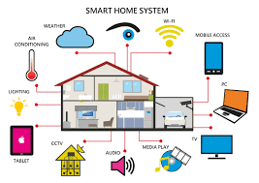
What is are Smart Homes ?
As defined by the Housing Learning & Improvement Network (LIN), a smart home is “a dwelling incorporating a communications network that connects the key electrical appliances and services, and allows them to be remotely controlled, monitored or accessed‘‘ [1]
The concept of Smart Homes plays an important role in the planning of future housing-based models of care.
Smart home representation. [2]

Slide 4
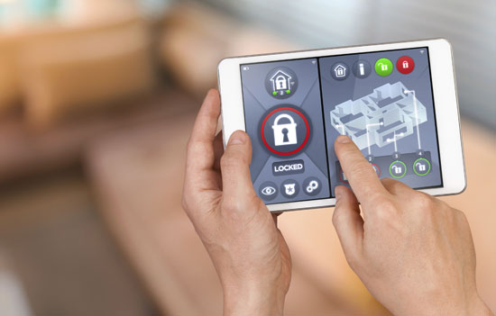
Why Develop Smart Homes ?
Using home automation could result in more effective and clever energy-saving methods. [3]
There is a lot of promise for family safety and security in home automation. A 2015 iControl poll found that "personal and family security" and "excitement about energy savings" are the two main factors driving demand for smart and connected devices. [4]
Example on security where locks can be controlled remotely [5]

Slide 5
In This Project:
A simple Smart home system has been created which includes the following components:
Remote Control
Display Screen
Light Control (Lamp and LEDs)
Door Control
Air Conditioner Control
Alarm Control

Slide 6
Hardware Used In This Project:
For the light control, 5 LEDs and 1 AC Lamp connected to a dimming
Circuit were used

Slide 7
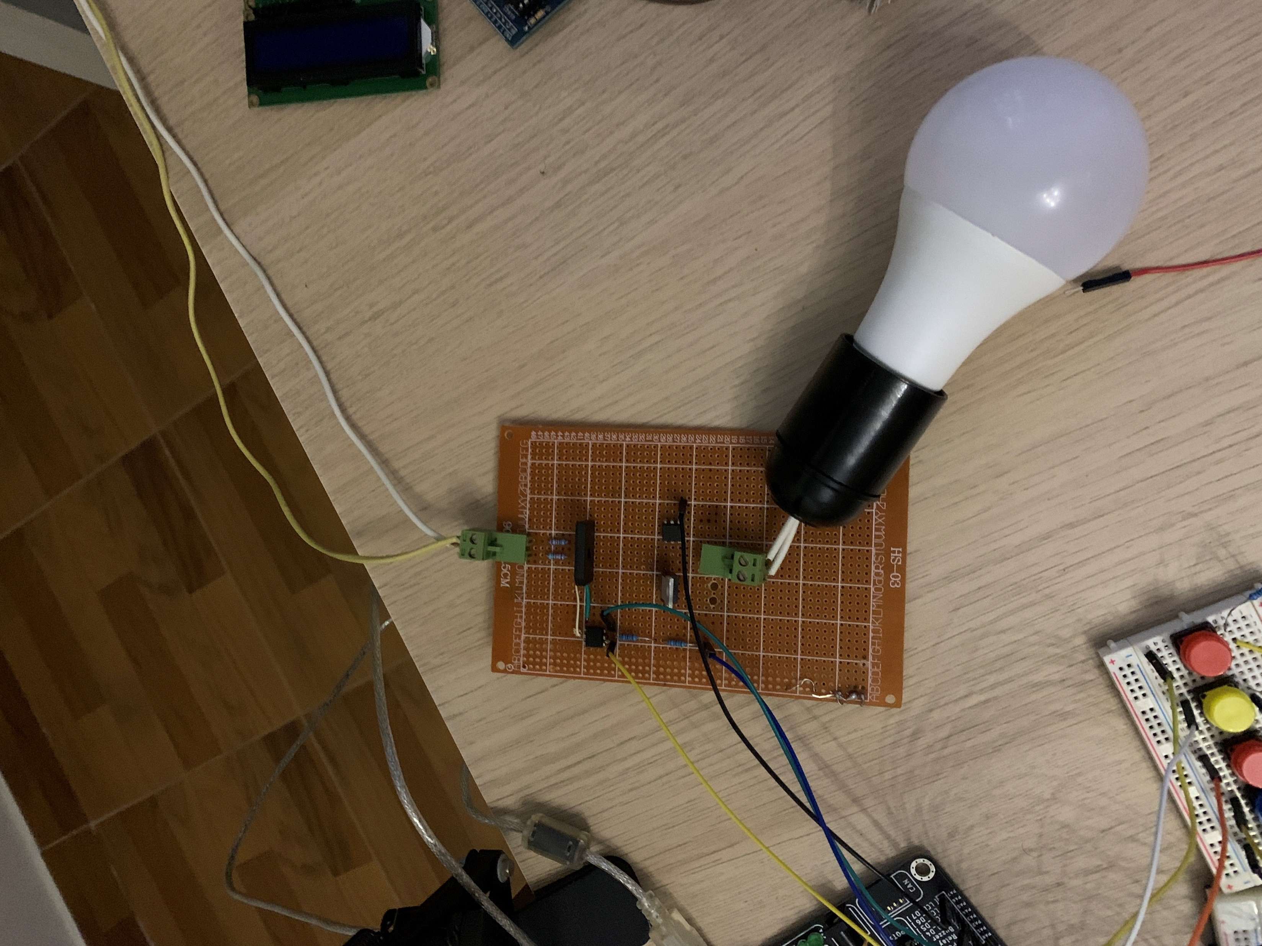
Hardware Used In This Project:
AC Lamp Dimming Circuit Components:
Full bridge rectifier
BT136 triac
4n25 Opto-coupler
MOC3021 Opto-coupler
Resistors
Jumpers
Veroboard
Hardware circuit of AC light dimmer

Slide 8
Hardware Used In This Project:
Rest of the components are:
HC-05 module.
5v buzzer
16x2 LCD
4x4 matrix keypad (and 5 Push buttons)
Atmega32 microcontroller
Android phone as remote controller
SG90 servo motor for door control
DC motor and a relay for the Air Conditioner
Various resistors
Jumpers
2 breadboards

Slide 9
The Communication
For the microcontroller, the UART communication protocol was setup using its corresponding registers. After that it waits for the phone signal.
For the remote controller which was an android smart phone in this case, the MIT Inventor app was used to create and app that sent messages to the controller via Bluetooth.
MIT App Inventor is a web application integrated development environment originally provided by Google, and now maintained by the Massachusetts Institute of Technology. [6]

Slide 10
The Messages
The app on the smart phone sends a message to the controller with each button click. These messages are made up of on byte characters. Based on the sent character the microcontroller reacts.

Slide 11
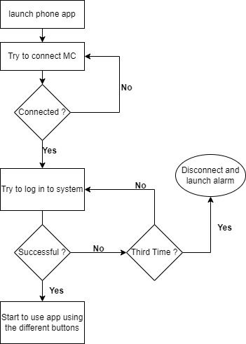
System Flow Chart

Slide 12
Proteus
Proteus was used along side the hardware implementation.

Slide 13
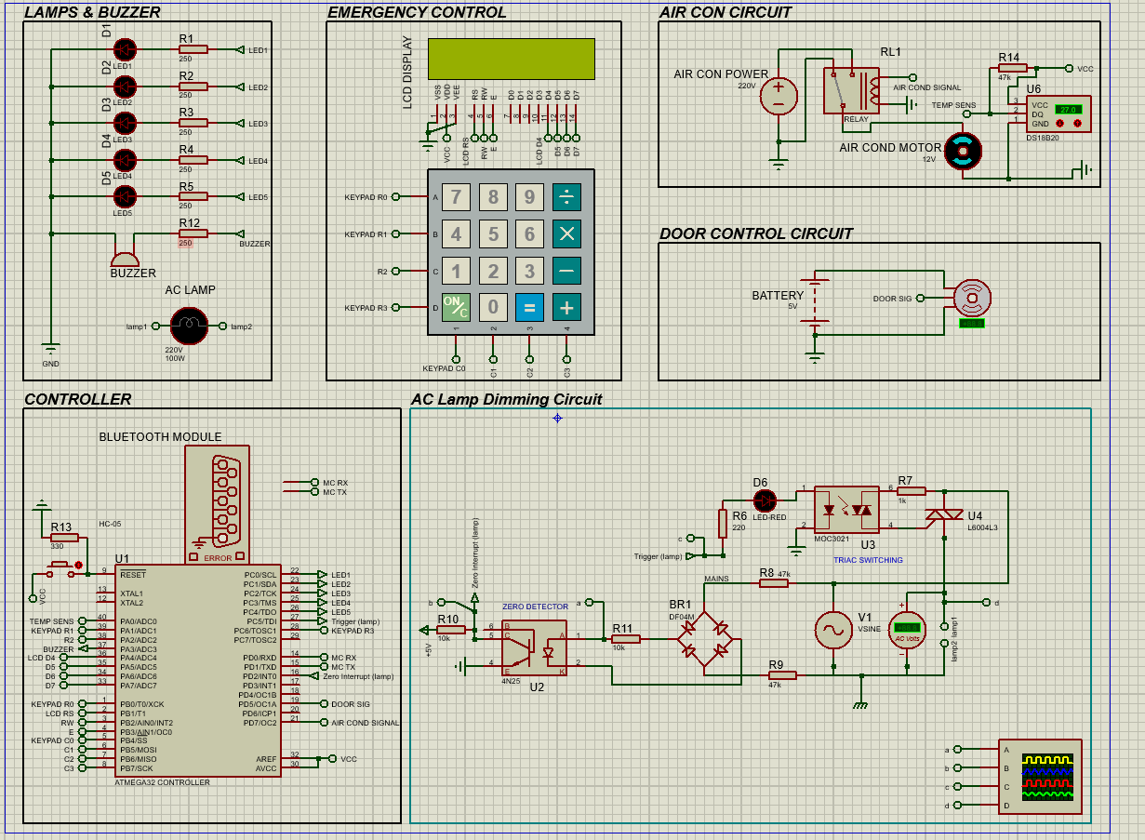
Proteus
Proteus diagram of the Smart Home system

Slide 14
Results
The system ran smoothly with no issues expect for the keypad which sometimes was not producing any output for the controller to interpret.

Slide 15
Summary:
A Smart Home system was created (hardware and simulation).
A smart phone app was created for communication.
Results showed that the system operated normally with expected output.

Slide 16
Li Jiang, Da-You Liu and Bo Yang, "Smart home research," Proceedings of 2004 International Conference on Machine Learning and Cybernetics (IEEE Cat. No.04EX826), 2004, pp. 659-663 vol.2, doi: 10.1109/ICMLC.2004.1382266.
Abstract: This paper is a survey for smart home research, from definition to current research status. First we give a definition to smart home, and then describe the smart home elements, typical research projects, smart home networks research status, smart home appliances and challenges at last. https://ieeexplore.ieee.org/stamp/stamp.jsp?tp=&arnumber=1382266&isnumber=30108
http://visioforce.com/smarthome.html
Risteska Stojkoska, Biljana L.; Trivodaliev, Kire V. (January 2017). "A review of Internet of Things for smart home: Challenges and solutions". Journal of Cleaner Production. 140: 1454–1464. doi:10.1016/j.jclepro.2016.10.006.
Heierman, E.O.; Cook, D.J. (2003). "Improving home automation by discovering regularly occurring device usage patterns". Third IEEE International Conference on Data Mining. Melbourne, FL, USA: IEEE Comput. Soc: 537–540. doi:10.1109/ICDM.2003.1250971. ISBN 978-0-7695-1978-4.
https://www.travelers.com/resources/home/smart-home/5-smart-home-automation-safety-tips
https://en.wikipedia.org/wiki/App_Inventor_for_Android

Slide 17

Thank You!!

